Slide 2


Appointment closing application
Konstantinos Kafantaris
Moysis Moysis

Slide 3




Development Tools Overview
Android Studio
Visual Studio Code
PostgreSQL
Node JS
Android Studio was used to demonstrate the front-end of the application
Visual Studio Code was used to host the server of our application
PostgreSQL was used to host the the database of the application
Node.js was used to connect the server with the database

Slide 4
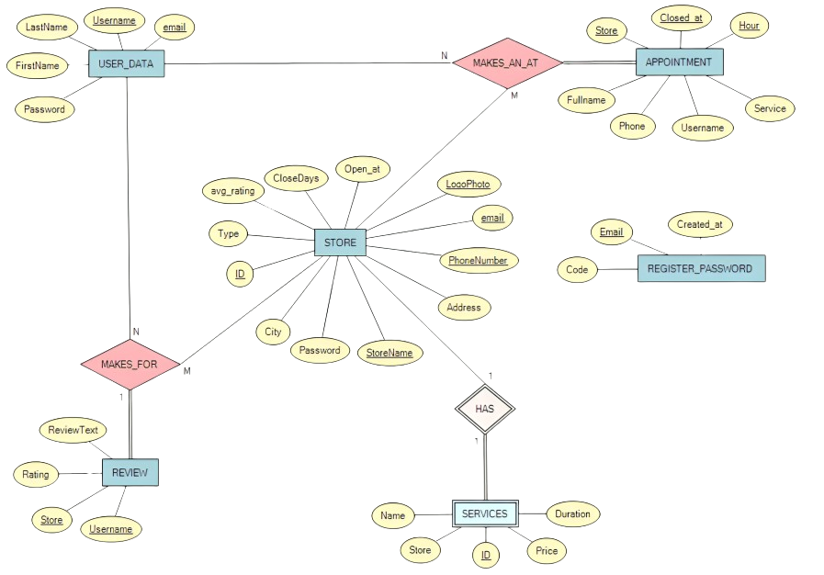
ER Database Diagram

Slide 5
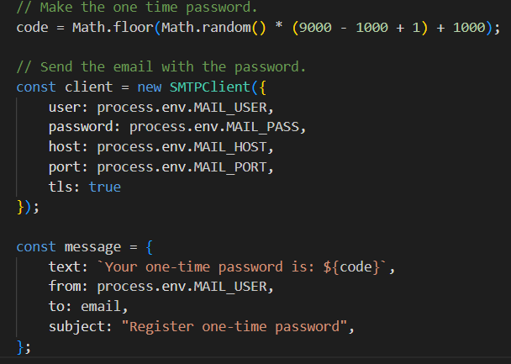

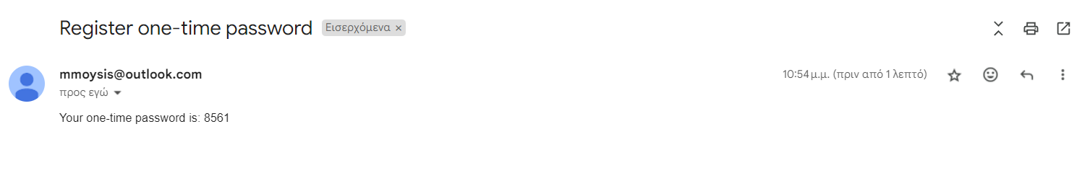
Security enhancement
One Time Password(OTP)
Password Encryption
The One-Time Password (OTP) is generated on the server, sent to the user's email, and is essential for completing the registration process. Upon submitting the OTP, the server verifies it, ensuring a seamless and secure registration experience
Password encryption is implemented to enhance the security of user accounts. Utilizing bcrypt, the password undergoes a robust encryption process, through hasing. The server manages any other necessary modifications for its appropriate use.

Slide 6
Connection android with server
private void sendOTP () { String url = "http://IP_address/user/send-otp"; Intent intent = getIntent(); String email = intent.getExtras().getString("email"); String username = intent.getExtras().getString("username"); JSONObject user = new JSONObject(); try { user.put("username", username); user.put("email", email); } catch (JSONException e) { } RequestQueue queue = Volley.newRequestQueue(OTP_check.this); JsonObjectRequest request = new JsonObjectRequest(Request.Method.PUT, url, user, new Response.Listener<JSONObject>() { @Override public void onResponse(JSONObject response) { try { String check = response.getString("sendOTP"); } catch (JSONException e) { throw new RuntimeException(e); } } }, new Response.ErrorListener() { @Override public void onErrorResponse(VolleyError error) { } }); queue.add(request); }
The server connection was established using the Volley library.
try { String check = response.getString("register"); if (check.equals("true")) { Intent logInIntent = new Intent(OTP_check.this, MainActivity.class); startActivity(logInIntent); finish(); } else if (check.equals("usernameFalse")) { errorMsg.setText("Username already exists"); errorMsg.setVisibility(View.VISIBLE); } else { errorMsg.setText("There is already an account registered with this email"); errorMsg.setVisibility(View.VISIBLE); } } catch (JSONException e) { throw new RuntimeException(e); }
Εικόνα 2: Επεξεργασία JSON response
Εικόνα 1: Αποστολή JSON request

Slide 7

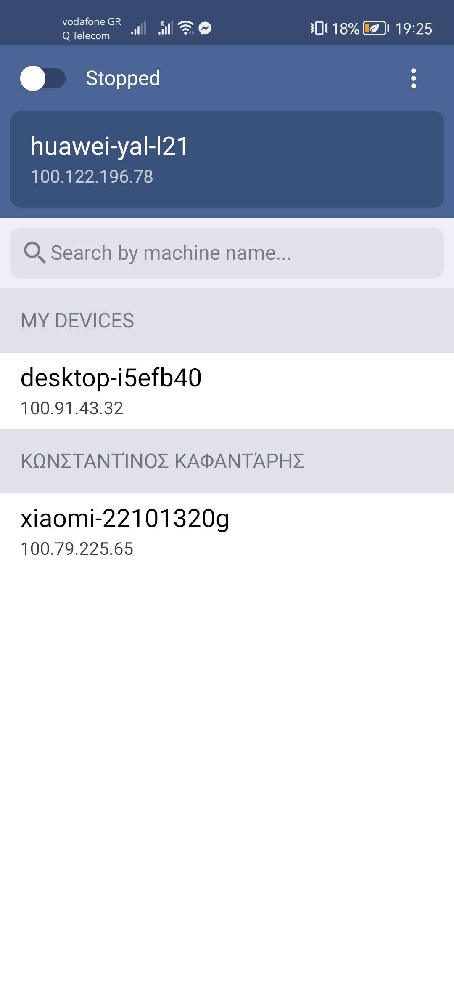
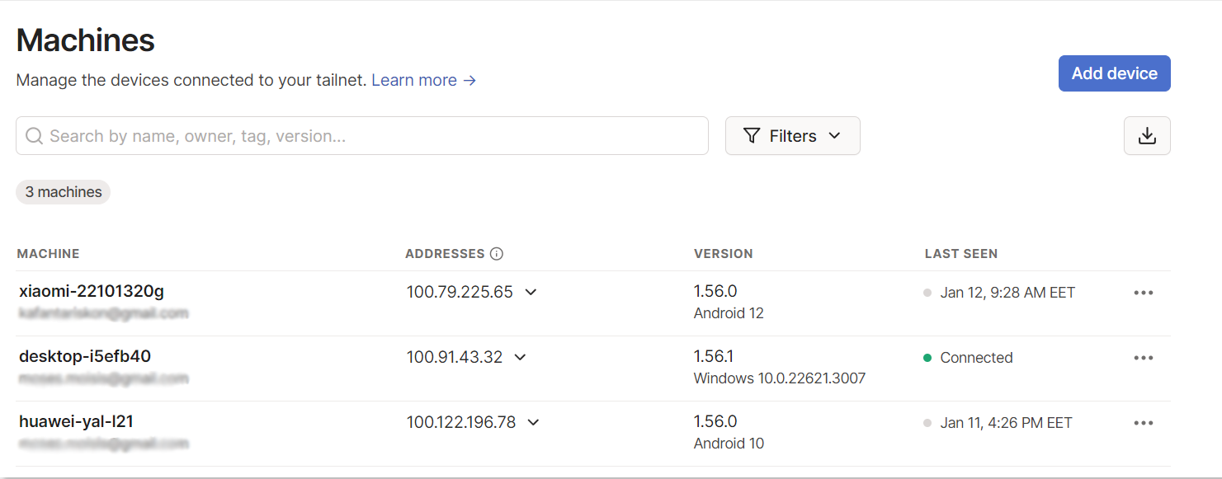
Vpn private network
Employed Tailscale to establish a secure connection between our mobile app and server on a private network, eliminating the need for port forwarding. This streamlined solution ensures seamless communication without compromising security for our application

Slide 8
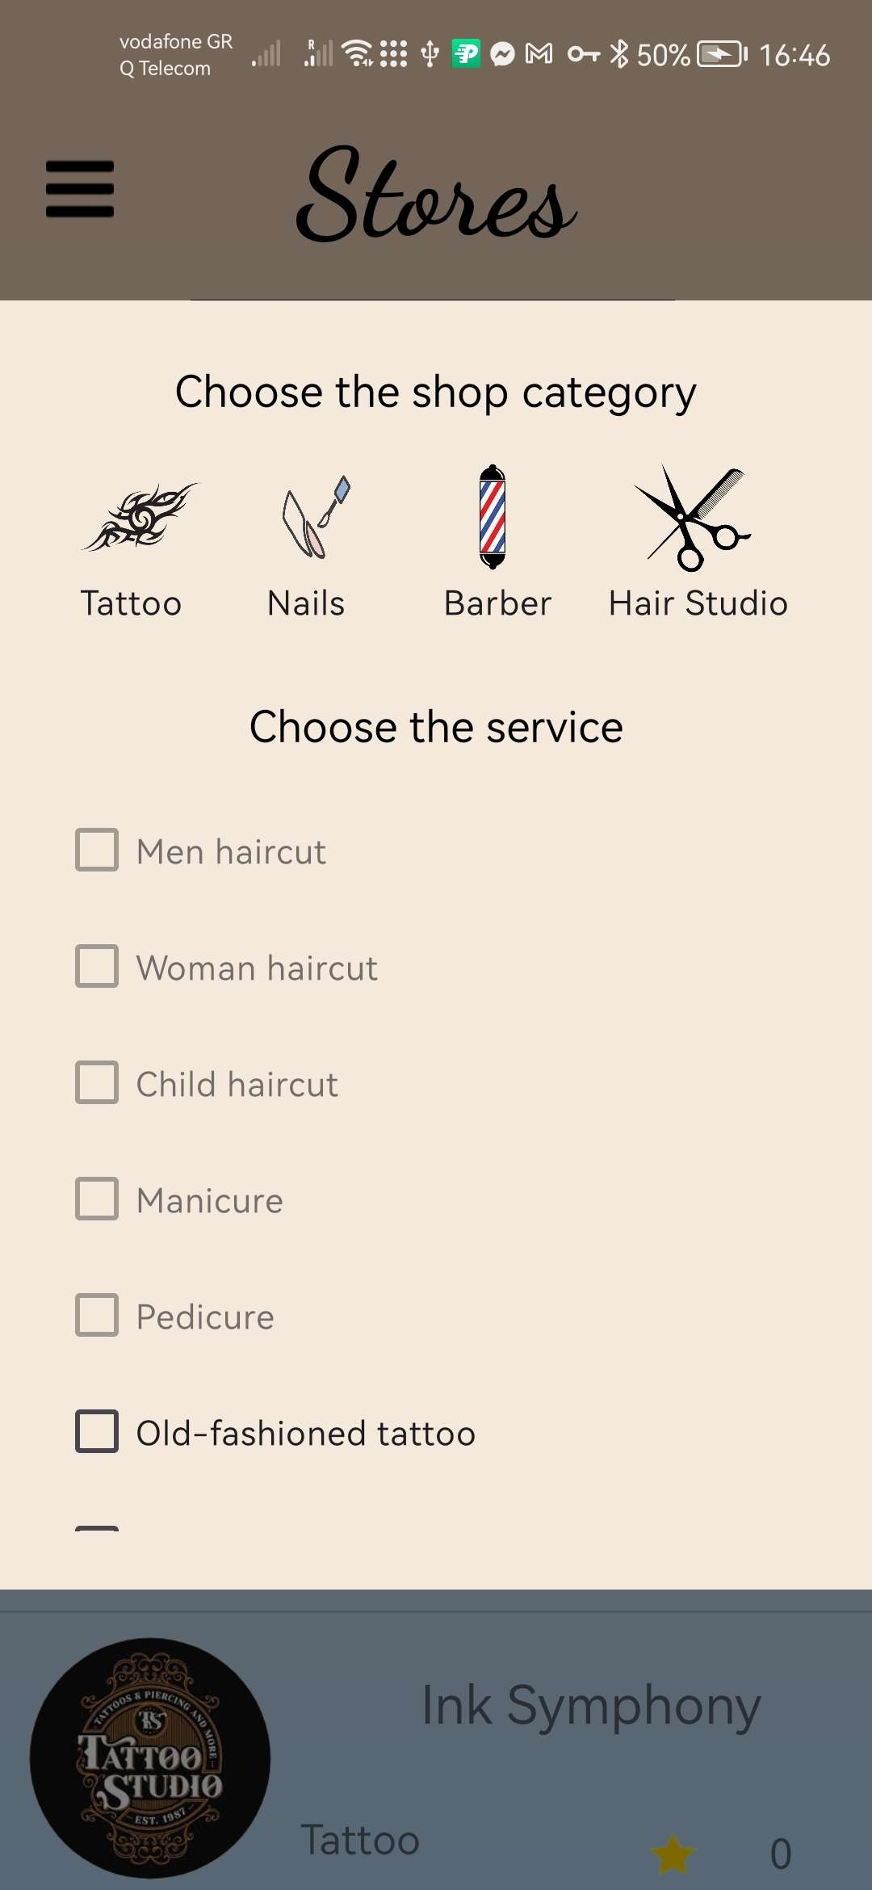
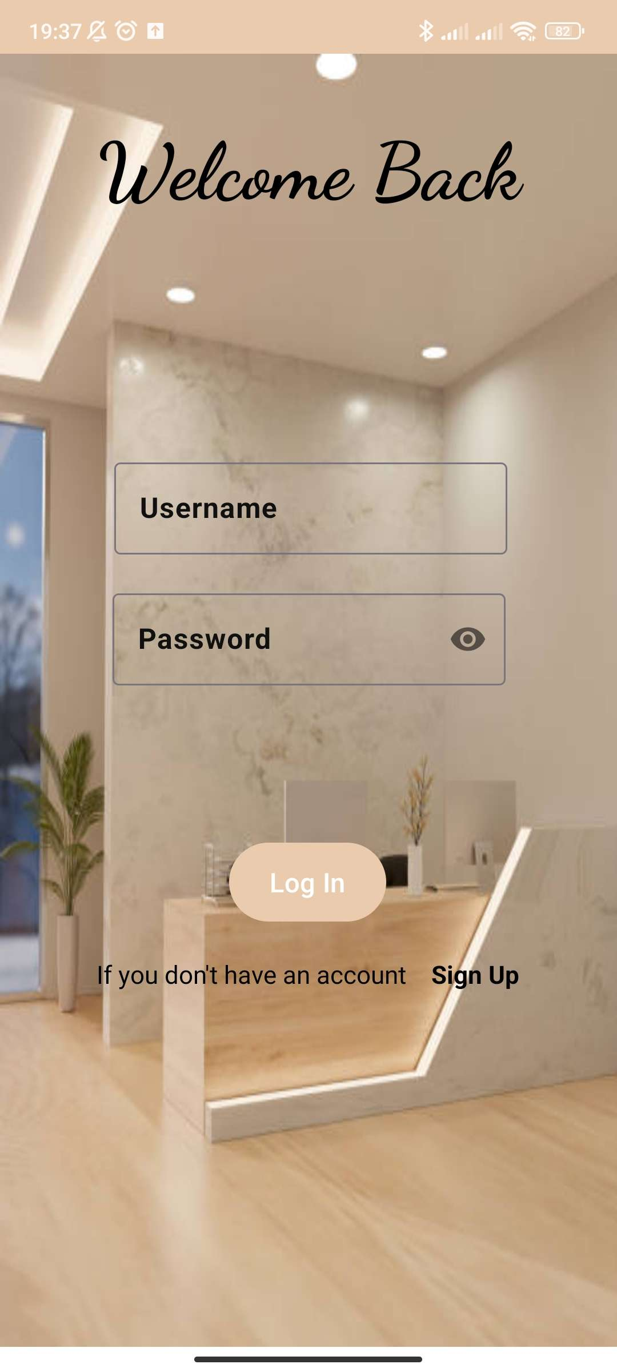
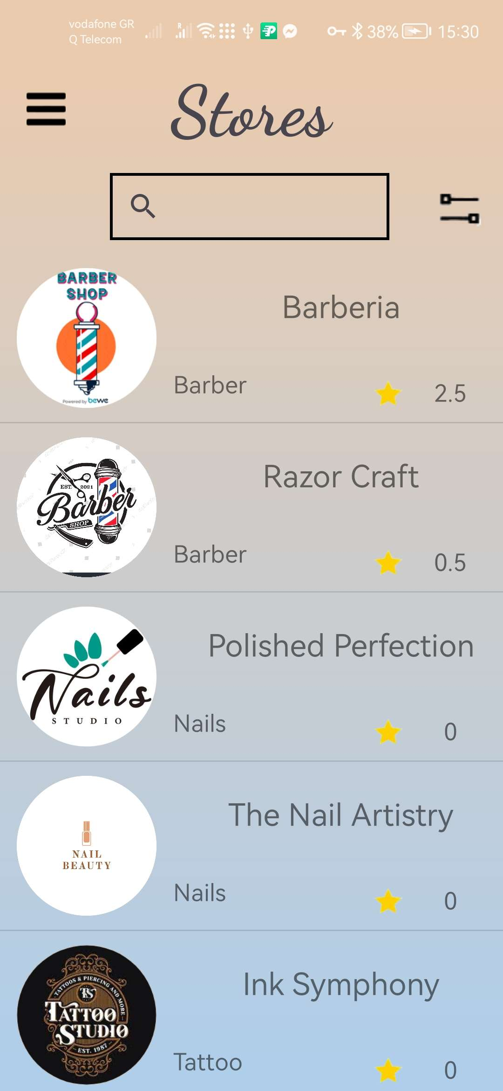
Quick demo

